Slide 1



Spencer Swindell
Health Trust
PRESENTING
Building a Data Lakehouse
www.TheAnalyticsSummit.com

Slide 2
README
Live in Mount Juliet, grew up here in Nashville
Computer Science at TTU
10 years working in data and analytics
This presentation is open source! Materials for this presentation, including this presentation, can be found at https://github.com/shswindell42/Presentations/tree/main/Building%20a%20Data%20Lakehouse

Slide 3
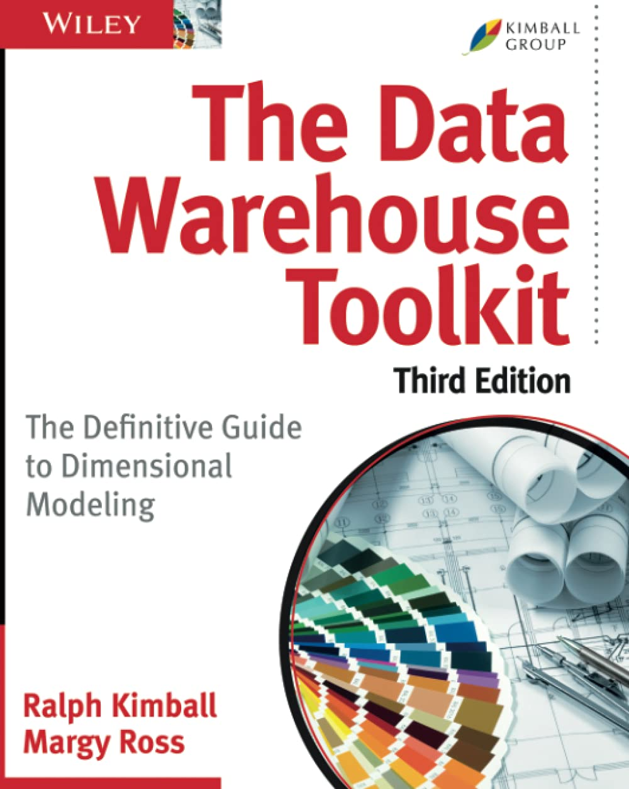
Introduction of Data Warehousing
OLTP vs OLAP
The Dimensional Model
Introduced by Ralph Kimball
See “The Data Warehouse Toolkit”
Data read into staging tables and transformed using SQL
Rigid schema on write

Slide 4
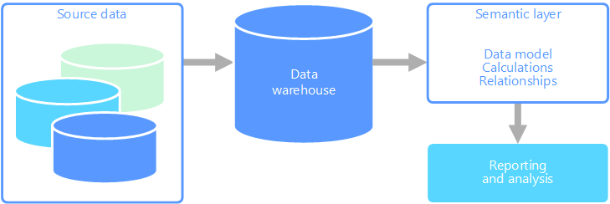
Early days of Data Warehousing

Slide 5
Introduction of the Data Lake
Data Lakes allow for more flexible storage of data
It’s just file storage!
Data first loaded into the Data Lake
Keep a copy of everything
Data copied into data warehouse system

Slide 6
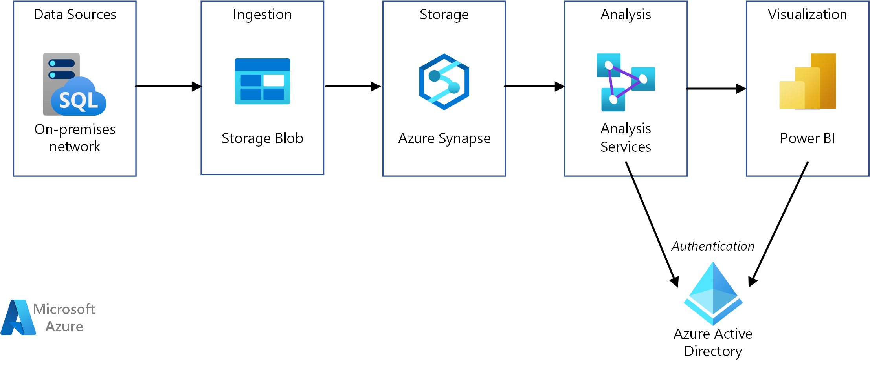
Data Warehouse with Data Lake

Slide 7
Data Lake Advantages
Separation of storage and compute
Consider the cost to keep a DW system up and running w/ little to no activity
Storage in a data lake is cheap
Turn on compute only when needed
Schema on Read
Store data in its native format, apply schema when attempting to read the data
Polyglot compute
The right tool for the right job
SQL
Spark
Custom code

Slide 8
Challenges with Data Lakes
No ability to update data in place
Files must be totally rewritten
Dependent on the compute layer to handle ACID Compliance
No native ability to recover from a crashed job
Files could get left in a corrupted state
No Consistency checks
No Isolation
A file re-write could impact other users attempting to read the data
Data Lake does handle Durability

Slide 9
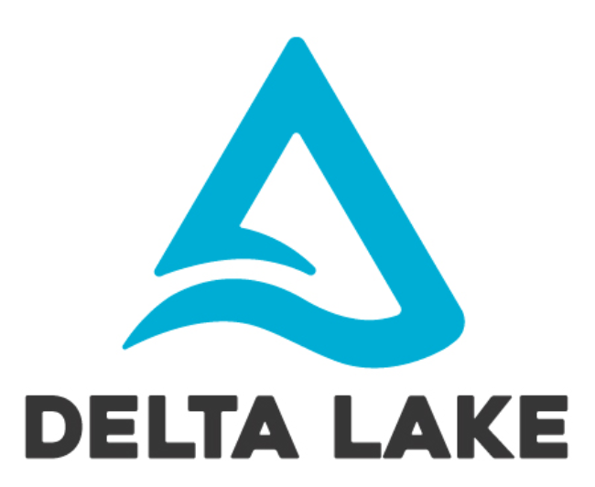
Solving these challenges
Many metadata layers have come up to try and solve these problems
Apache Iceberg – https://iceberg.apache.org/
Apache Hudi - https://hudi.apache.org/
Delta Lake - https://delta.io/
We will use Delta Lake in the examples today
Delta Lake developed by Databricks
Works well with Spark
Integrations with
Azure Synapse Analytics
Snowflake
AWS Redshift

Slide 10
Delta Lake
A Delta Lake table is
A directory of data objects
These are stored as parquet files
A log of transactions and metadata
Called _delta_log
Json files, with checkpoints as parquet files
The data objects are immutable
The log tracks which files belong to which “version” of the table
Keeps track of the schema allowing for schema evolution

Slide 11
Delta Lake
Delta lake provides ACID guarantees inside the Data Lake
The log tracks transactions, if a transaction fails the log isn’t updated and the current version remains intact
The log tracks the schema and maintains consistency
Transactions are isolated
Optimistic concurrency (https://docs.delta.io/latest/concurrency-control.html)
While a write is taking place, readers read the current version
Simultaneous writes can take place, a validation occurs before committing to the log to check if the same partitions have been modified

Slide 12
Demo
Examine a delta lake table
See the parquet files
See the log files
Run a transaction
See how the parquet files change
See how the log folder changes

Slide 13
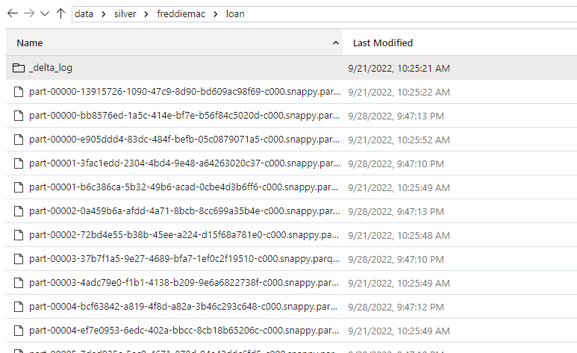

Slide 14
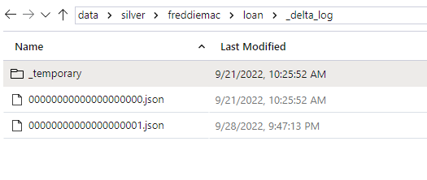

Slide 15
Data Lakehouse
Using Delta Lake we gain many of the properties a RDMS gives us
This allows us to use the Data Lake more like a traditional Data Warehouse
Data WareLakehouse
Removes the need for a traditional data warehouse
Systems operate directly with the data lakehouse in the way they need to
SQL API
Azure Synapse Serverless SQL Pools
DataFrame API
Spark/Pandas

Slide 16

Medallion Architecture
Bronze
Raw data ingested directly into the Data Lake
Silver
Validated data
Gold
Enriched and Aggregated, ready for Analytics
Dimensional Model

Slide 17
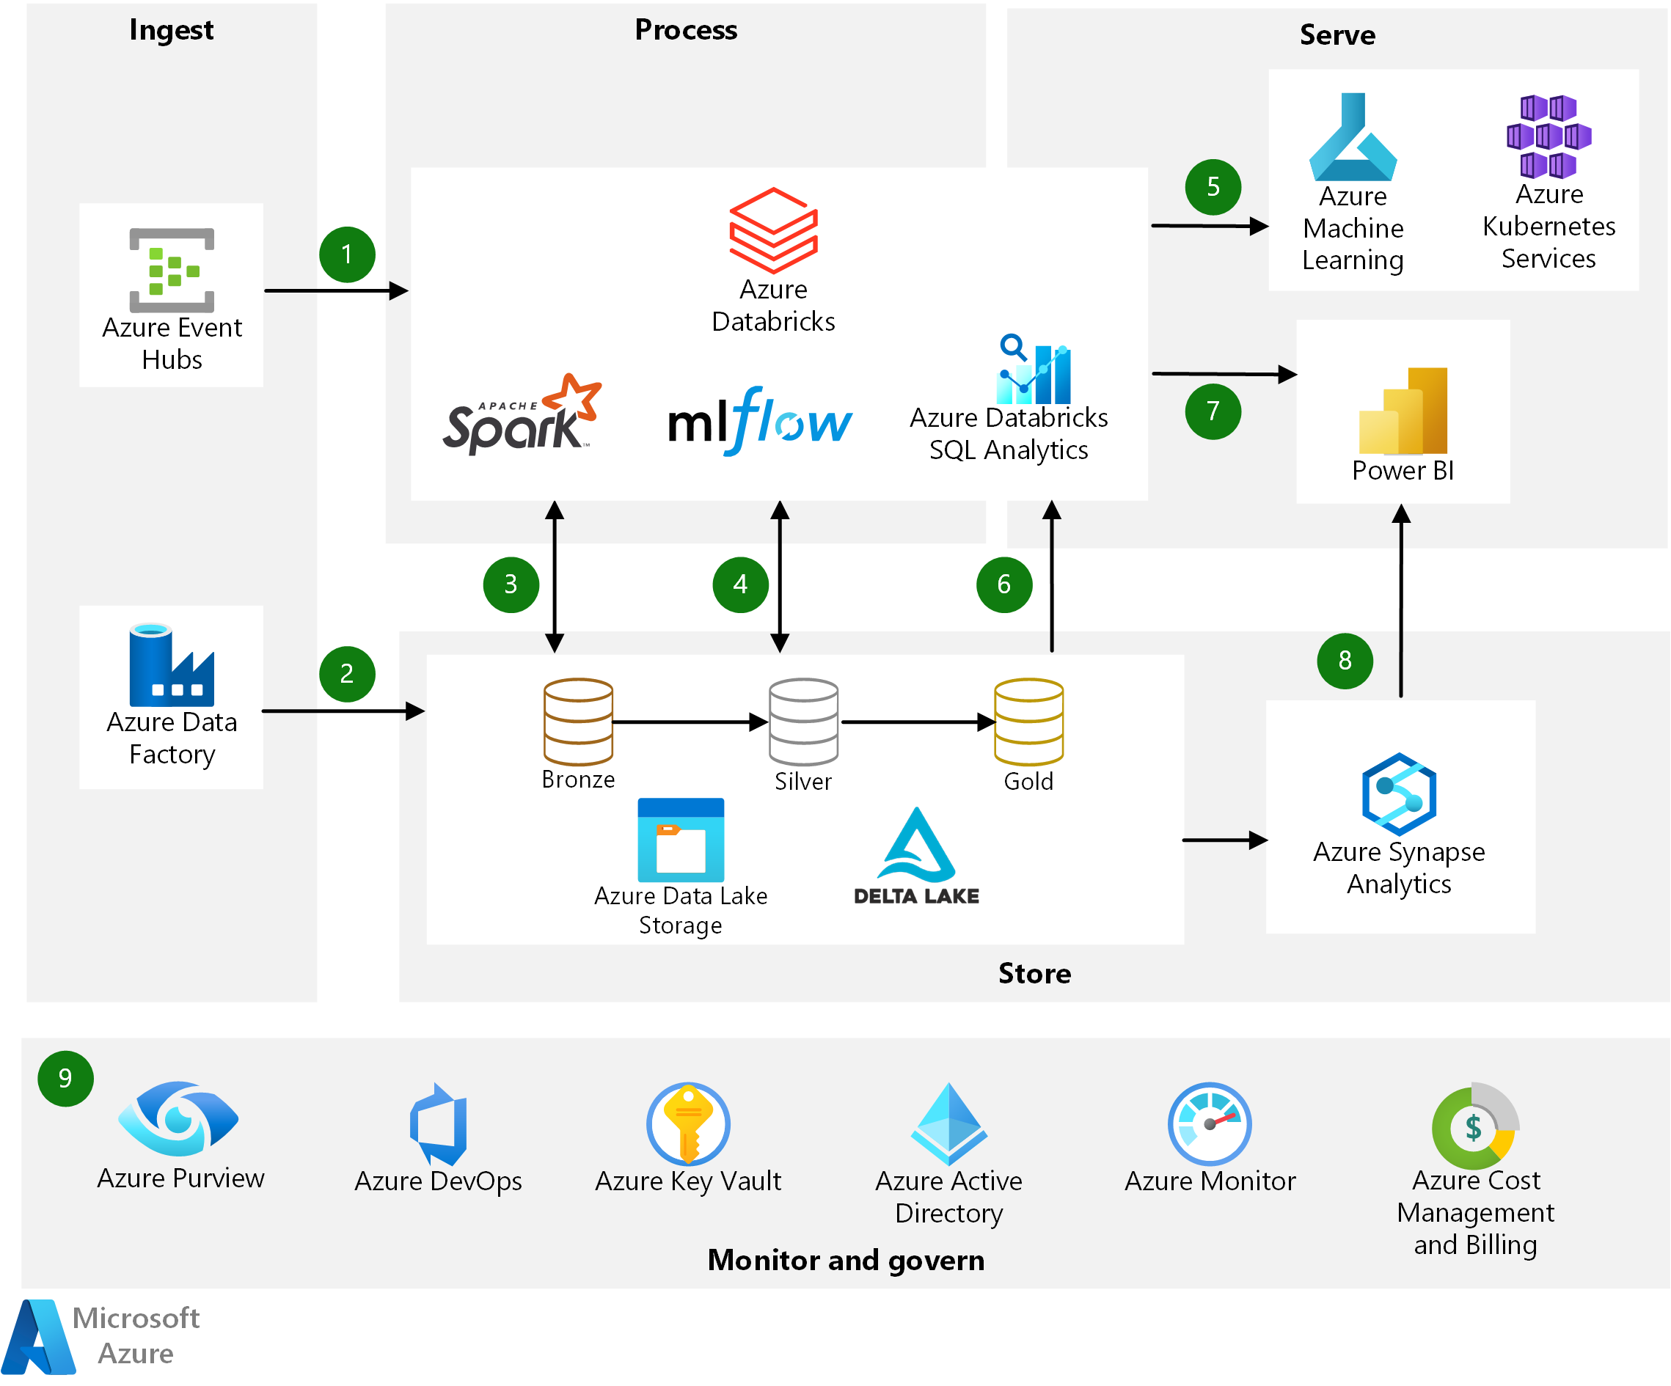
Sample Data Lakehouse
Data is ingested into the Bonze zone as is, available for systems to access as needed
Bronze data is standardized and validated then written into the silver zone
Silver data is filtered, enriched, and/or aggregated into the gold zone.
These are just folders in the data lake!

Slide 18
Demo
Raw ingestion of FreddieMac Data into the bronze layer
Apply schema and validate data into the silver layer, this is a delta lake table
Produce aggregated view in the gold layer
Connection with Power BI using Synapse Serverless SQL

Slide 19
Final Thoughts
The data warehouse is not dead!
Technology changes, principles do not
Modeling of the data still matters!
Flexibility of storage does NOT remove the necessity model data
The Dimensional Model is still relevant!

Slide 20
Related Resources
Data Warehouse Toolkit - https://www.amazon.com/Data-Warehouse-Toolkit-Definitive-Dimensional-ebook/dp/B00DRZX6XS
Lakehouse Whitepaper - https://www.cidrdb.org/cidr2021/papers/cidr2021_paper17.pdf
Delta Lake whitepaper - https://www.databricks.com/wp-content/uploads/2020/08/p975-armbrust.pdf
Medallion Architecture - https://docs.microsoft.com/en-us/azure/databricks/lakehouse/medallion
Azure Architectures
https://docs.microsoft.com/en-us/azure/architecture/reference-architectures/data/enterprise-bi-synapse
https://docs.microsoft.com/en-us/azure/architecture/data-guide/relational-data/online-analytical-processing
https://docs.microsoft.com/en-us/azure/architecture/solution-ideas/articles/azure-databricks-modern-analytics-architecture

